Slide 1
LinkedIn Edunet
[Banking Customer Account Dashboard]
P R E S E N T A T I O N 2 0 2 6
👤
Student Name
✉
Student Email
[Gonepalli Amulya]
[gonepalliamulya@gmail.com]
📖
[Umamaheswari]

Slide 2
edunet
foundation
Abstract
.
This project focuses on analyzing banking customer account data to understand financial behavior.
It helps in monitoring key factors like income, expenses, savings, and transaction patterns.
The data is collected, cleaned, and processed to generate meaningful insights.
Interactive dashboards are created to display account balance trends and spending habits.
The project helps identify financial risks and opportunities for better money management.
The system supports better decision-making for customers and banks. Overall, the project simplifies complex financial data into easy-to-understand visuals and insights.
.
.

Slide 3
edunet
foundation
OUTLINE
• Abstract of the Project
• Problem Statement
• Proposed Solution
• System Architecture
• Live Demo of the Project
• Embedded Video of Project
• Conclusion
• Future Scope

Slide 4
edunet
foundation
Problem Statement
Many banking customers do not have a clear understanding of their financial health.
Financial data like transactions, income, and expenses are scattered and difficult to analyze.
Traditional bank statements are complex and not user-friendly.
Customers are unable to identify unnecessary expenses or financial risks.
Existing systems do not provide real-time insights or personalized financial analysis
.
.

Slide 5
edunet
foundation
Proposed Solution
Develop a Banking Customer Account Dashboard to analyze financial data easily. Collect customer data such as transactions, income, expenses, and account balances. Use Excel for data cleaning and preprocessing to ensure accuracy. Apply Power BI to create interactive dashboards and visualizations. Display key metrics like total balance, monthly spending, savings, and income trends.The proposed solution is to develop a Banking Customer Account Dashboard that enables users to easily analyze and understand their financial data. The system collects important customer information such as transaction details, income, expenses, and account balances. This data is then cleaned and preprocessed using Excel to remove errors, duplicates, and missing values, ensuring accuracy and reliability.

Slide 6
edunet
foundation
System Architecture
Data Input / Source
Processing / Analysis
Collect data from banking records such as:
Customer account details
Transaction history
Data can be taken from Excel files, CSV files,
or databases
Clean the data by:
Removing errors and duplicates
Handling missing values
Organize data into proper format (tables,
categories)
AI / Tool Integration
Output / Dashboard
Use Excel for data cleaning and basic
analysis
Use Power BI to build dashboards and
visualizations
Use AI tools (Copilot/ChatGPT) to:
Generate insights
Use charts like:
Bar charts
Pie charts
Line graphs
Provide easy-to-understand insights for
users

Slide 7
edunet
foundation
Video of Project Demo
[https://your-project-demo-link.comhttps://drive.google.com/file/d/1jIVi-1Hjcm9CnN050y8BjdatvLX3MuXA/view?usp=drivesdk]
▶
[Insert your project demo video.
You can embed a video your live project.]

Slide 8
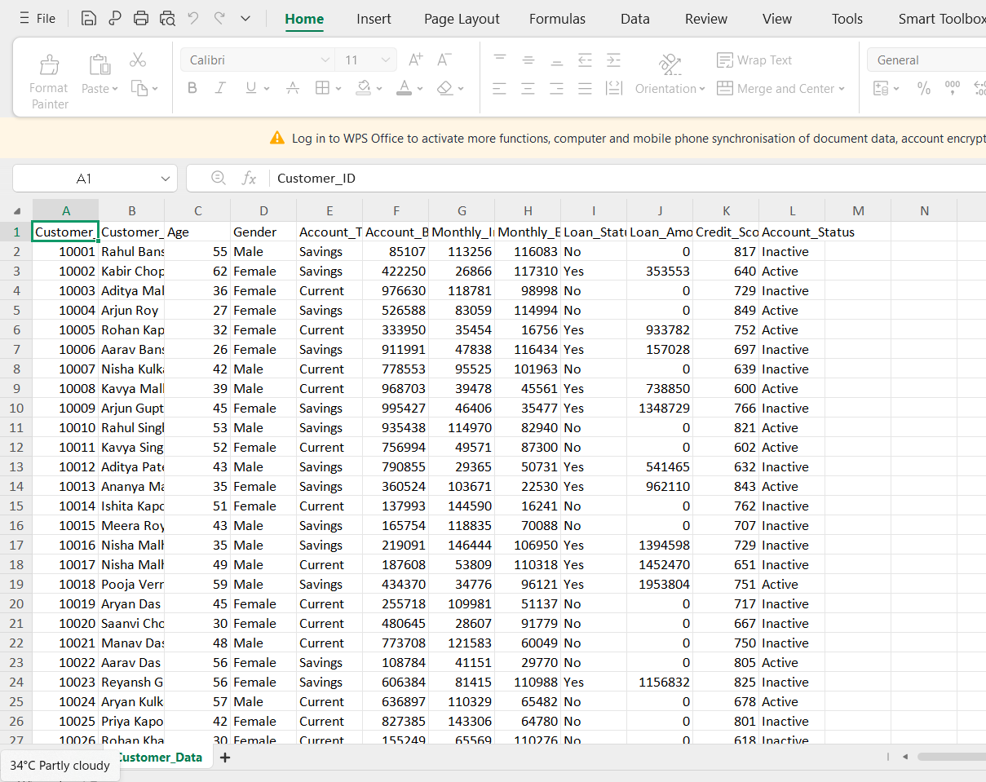
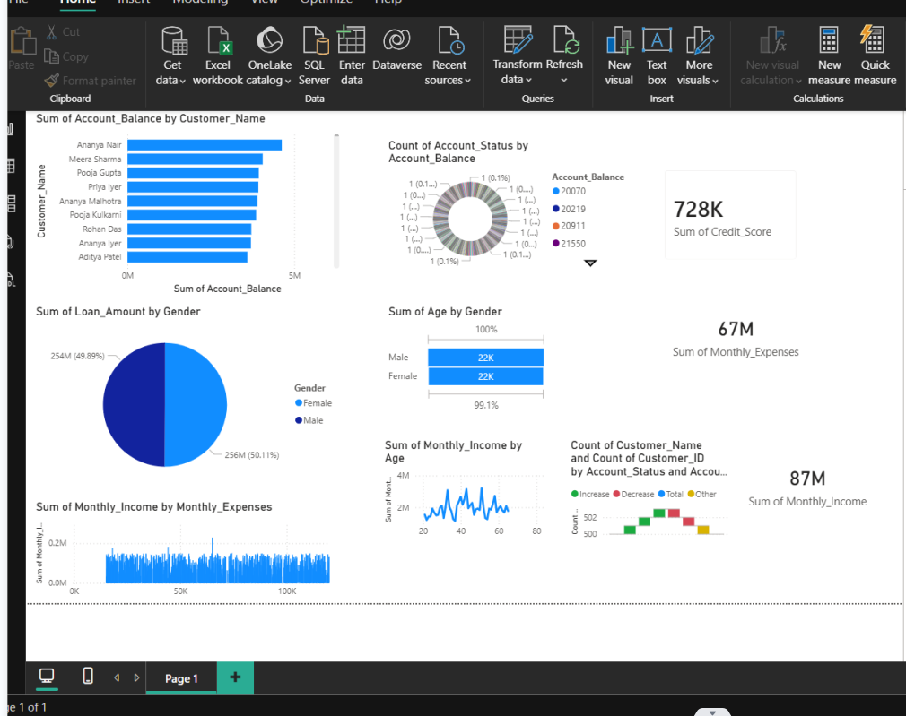
edunet
foundation
Live Demo of Project
Here's the list of some demo screenshots / features of the project:
🖼
🖼
🖼
Demo 1
Demo 2
Demo 3
[Add description of Demo 3 here — what this demo shows, key features, and results achieved.]

Slide 9
edunet
foundation
Conclusion
The project successfully developed a Banking Customer Account Dashboard for effective financial analysis. It helped in organizing and analyzing customer financial data in a structured manner. The dashboard provides clear and meaningful insights into income, expenses, and savings patterns, making financial information easy to understand. By using tools like Excel, Power BI, and AI, the analysis becomes more efficient and accurate. Overall, the system enables users to better understand their financial health through simple and interactive visualizations, supporting improved financial decision-making.the project helps users gain a deeper understanding of their financial behavior, enabling them to identify unnecessary expenses and potential financial risks. It also supports better financial planning by highlighting trends and patterns over time. The integration of AI tools enhances insight generation, making the system smarter and more efficient.
✅
• Abstract of the Project
• Problem Statement
• Proposed Solution
• System Architecture
• Live Demo of the Project
• Embedded Video of Project
CONCLUSION
• Conclusion
• Future Scope

Slide 10
edunet
foundation
Future Scope
🧠
Add real-time data integration from bank servers for live updates. Use advanced AI/ML models to predict future expenses and savings. Provide personalized financial advice based on user behavior. Develop a mobile application for easy access anytime, anywhere. Integrate with multiple bank accounts and UPI apps in one dashboard.The project can be further enhanced by integrating real-time data from bank servers, allowing users to access up-to-date financial information instantly. Advanced AI and machine learning models can be implemented to predict future expenses, savings, and financial trends, helping users plan better. The system can also be improved by providing personalized financial advice based on individual spending behavior and income patterns. Additionally, developing a mobile application would make the dashboard more accessible, enabling users to monitor their finances anytime and anywhere.
• Abstract of the Project
• Problem Statement
• Proposed Solution
• System Architecture
• Live Demo of the Project
• Embedded Video of Project
• Conclusion
[Future ideas & roadmap]
• Future Scope

Slide 11
edunet
foundation
Thank You
AICW Fellowship | Student Project Presentation 2026
LinkedIn | Edunet Foundation

